Slide 1
Project 3: Final
WANG Meng

Slide 2
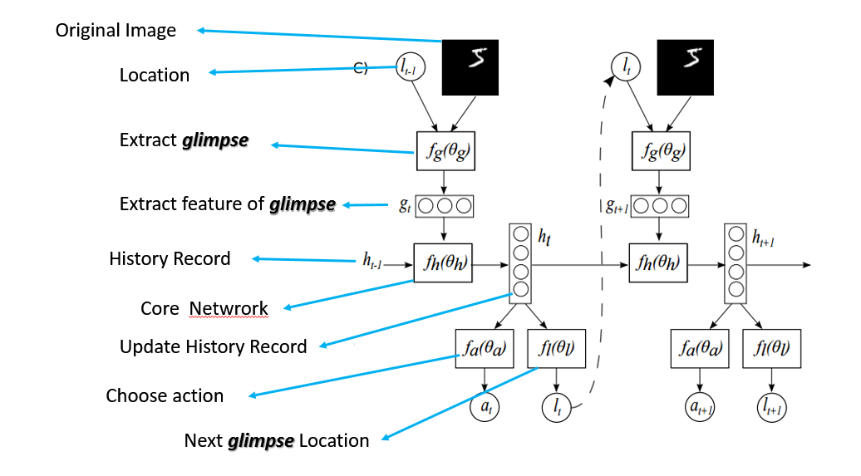
Problem 1: Reinforcement Learning for Image Classification with Recurrent attention Models
Diagram of RAM
Notes:
How presentation will benefit audience: Adult learners are more interested in a subject if they know how or why it is important to them.
Presenter’s level of expertise in the subject: Briefly state your credentials in this area, or explain why participants should listen to you.

Slide 3
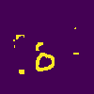
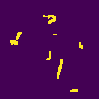
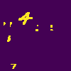
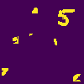
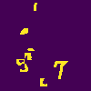
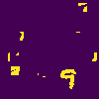
Augmented MNIST Dataset
The original MNIST is augmented with additional noise and distortion in order to make the problem more challenging and closer towards real-world problems.
Cluttered non-centered MNIST dataset

Slide 4
Augmented MNIST Dataset
The translation is generated by randomly select a position to translate the original 28x28 image in a 100x100 canvas.
The distortion noise is generated by randomly select a raining/validation 28x28 image, then randomly crop a 9x9 patch for 8 times, then stitch all the 8 cropped images to the augmented 100x100 image.
Each image pixel value is normalized in the range of [0, 1].

Slide 5
Key ideas
Attention:
Humans focus attention selectively on parts of the visual space to acquire information when and where it is needed; reduce the task complexity;
Recurrent Neural Network:
Combine information from different fixations over time to build up an internal representation of the scene;
Reinforcement:
Guiding future eye movements and decision making.

Slide 6
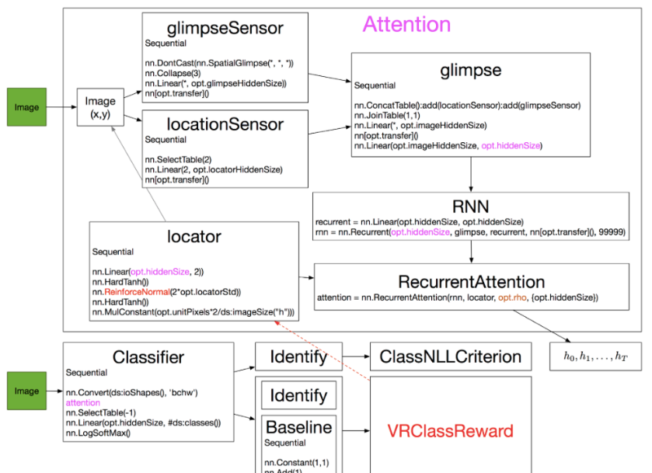
RAM Model

Slide 7
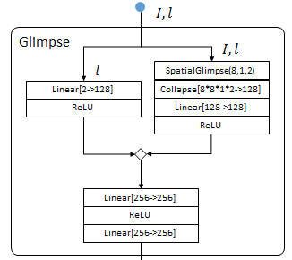
Glimpse network
Input: I is the image (100*100*1), L is the location (2*1);
Output: a vector g (256*1);
Model:
The left part is to reshape location input to (128*128) using a hidden layer and ReLU; contains the information of the focused location of glimpse;
The right part is used to extract glimpses and reshape to (128*128); SpatialGlimpse represents the function of extract glimpses; Each glimpse is 8*8*1 (height*weight*channels) and there are 2 (the number of scales) scales (different resolutions); Then append these scaled glimpses and reshape to 128*1; contains the information of retina representation.
The bottom part is used to combine the location input and glimpse input linearly and reshape to 256*1.

Slide 8
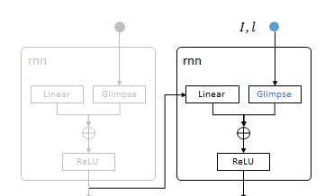
Core network
Input: Glimpse is the extracted feature vector from Glimpse network, and the hidden unit h_t comes from the internal state, i.e. the previous result.
Output: hidden unit h_t+1;
Model:
The core network is just a simple recurrent neural network. The internal state maintains the information from the previous result and is successively used to decide the action and replace the glimpse sensor.
lstm_cell = rnn_cell.LSTMCell(config.cell_size, state_is_tuple=True)

Slide 9
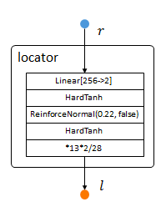
Location network
Input: the hidden unit h_t from the internal state, i.e. the previous result.
Output: the next location of glimpse sensor;
Model:
The location network determines where to move and explores the unknown part of the image based the previous observations. It uses a stochastic process to generate location and uses reinforcement learning methods to learn.
Basically, the HardTanh part is used to normalize the input between -1 and 1; The linear part is used to reshape the input (256) to location vector size (2). The reinforceNormal is used to sample form normal by reinforcement learning rules. (0.22 is the locator stand derivation.

Slide 10
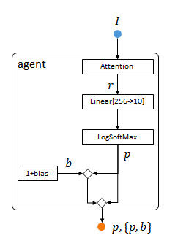
Agent
Input: the hidden unit h_t from the internal state;
Output: prediction of the digit;
Model:
the prediction result is used to generate the reward point, which is used to train the Location Network (since the stochasticity makes it non-differentiable).

Slide 11
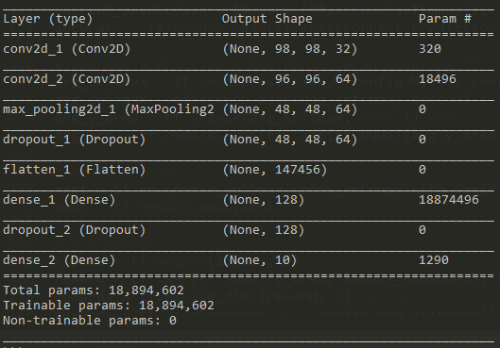
Baseline
Input: cluttered MNIST images;
Output: prediction of the digit;
Model:
2 convolution layers followed by max pooling;
Dropout as the regularization method;
The final test accuracy is 50%;
Baseline network

Slide 12

Reinforcement Learning
Input: the hidden unit h_t from the internal state;
Output: the next location and action;
Model:
Basically, we want to optimize the next location after we know the internal state (information from the previous internal state and location input and glimpse tensor); The solution is sampling from a Gaussian distribution with mean (u) which is the learn target and fixed standard deviation (delta); the location network use this stochastic process to generate the next glimpse location and get a reward.; the policy (mapping from states to actions) gradient tries to learn the direction in which we can get more reward, i.e. learn the Gaussian distribution parameter (u);
Reinforcement learning framework

Slide 13
Training
Stop_gradient:
set tf.stop_gradient to pass through gradient directly to differentiable network, then use a hybrid loss function to train only the differentiable network as an approximation.
Hybrid loss:
Loss = Cross-Entropy – (R – b_freeze) * loglikehood + (R – b) * (R – b)
Here Cross Entropy is used for evaluate prediction correctness; R is the actual reward, b_freeze is the gradient of baseline score function and the middle loss part is an MLE for regressing the optimal mean of our Gaussian distribution; b is the score function and the right loss part is the mean square error of baseline score and real reward;
Monte Carlo sampling:
Sample the same image for many times and take average as precision result;

Slide 14
Hyper parameters
Hyperparameter | Value
Glimpse sensor window size | 12
Number of glimpse per image | 8
Number of scales | 4
Batch size | 128
Number of epochs | 1000
Learning rate | 1e-3 with 0.97 decay, 1e-4(min)
Sensor total size | 12*12*1(channels)*4(scales)
Standard deviation | 0.22

Slide 15
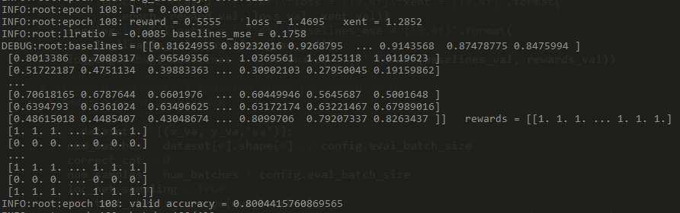
Results
Running log
The final test error is 20% which is lower than the original result (10.83%) with the same parameters (8 glimpses, 12*12 window size, 4 scales), which is due to the different methods to generate cluttered MNIST data.

Slide 16
Reference
Mnih, Volodymyr, Nicolas Heess, and Alex Graves. "Recurrent models of visual attention." Advances in neural information processing systems. 2014.
https://towardsdatascience.com/visual-attention-model-in-deep-learning-708813c2912c
https://github.com/tianyu-tristan/Visual-Attention-Model
https://blog.csdn.net/c602273091/article/details/79059445

Slide 17
Problem 2: Generating Images via Generative Models
In this project, you are required to train a generative model with given dataset to generate new images.
The generative models include, but not limited to, the models mentioned in 2.1.
It is suggested to use datasets in 2.2.
It is recommended to have some analyses and discussion on new images with the trained generative model. You may use some evaluation in 2.3.

Slide 18
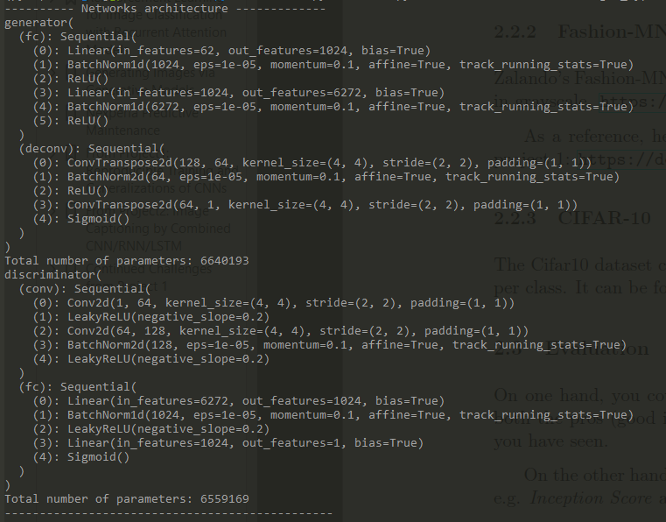

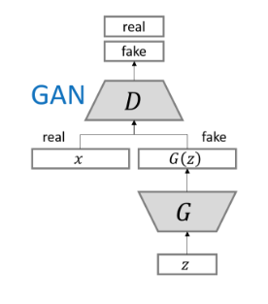
GAN value function and structure

Slide 19
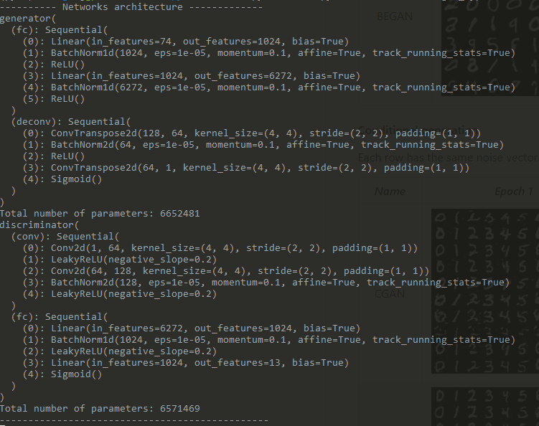

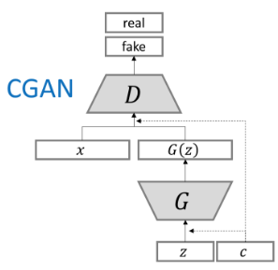
CGAN value function and structure

Slide 20
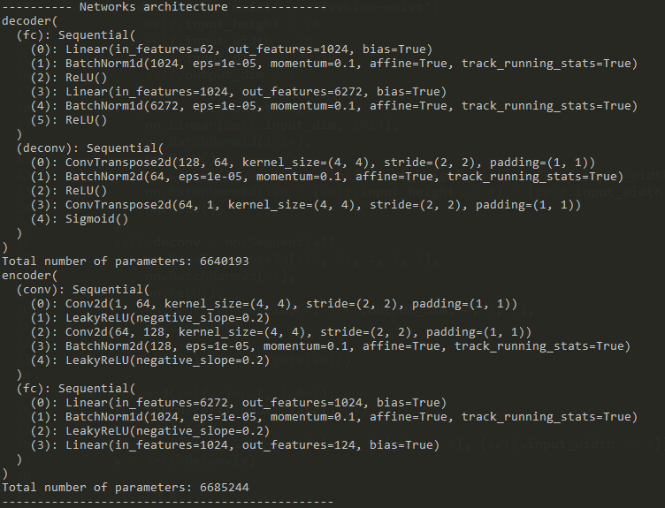
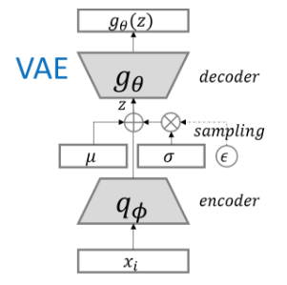
VAE value function and structure

Slide 21
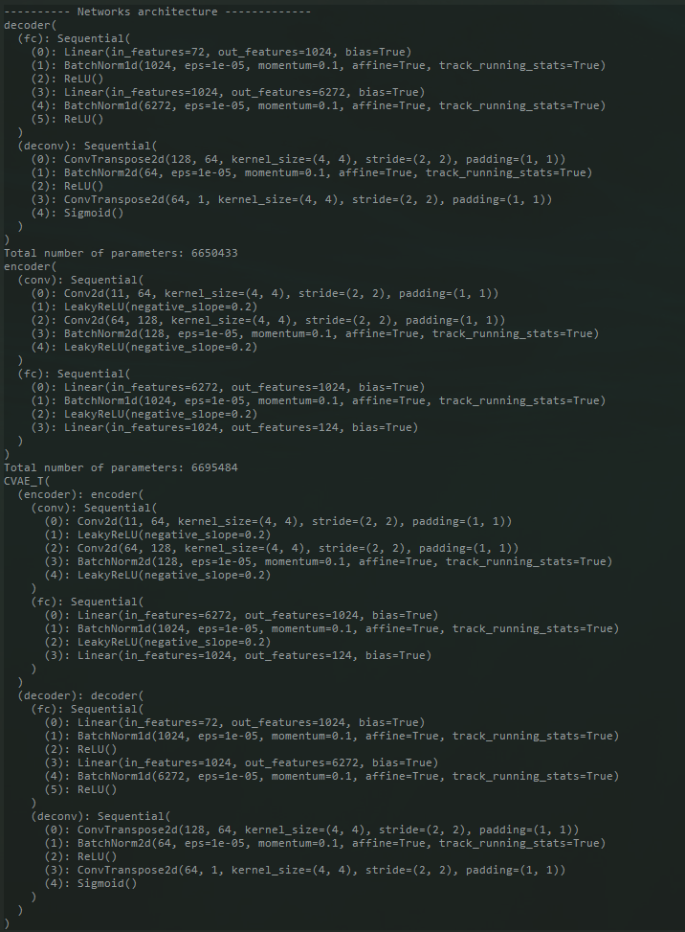
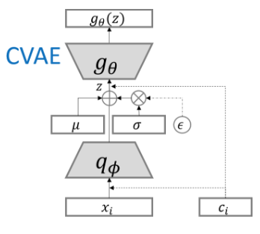
CVAE value function and structure

Slide 22
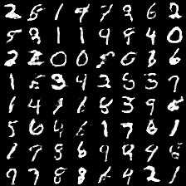
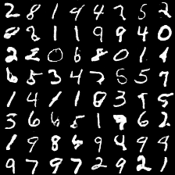
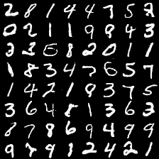
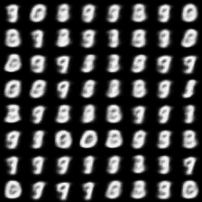
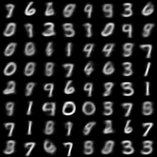
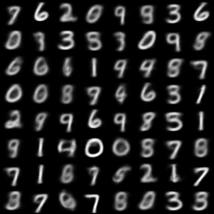
MNIST
Epoch2
Epoch10
Epoch25
GAN
Epoch2
Epoch10
Epoch25
VAE

Slide 23
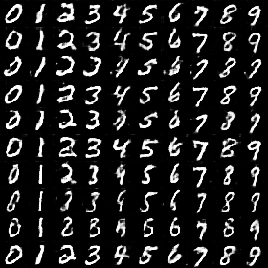
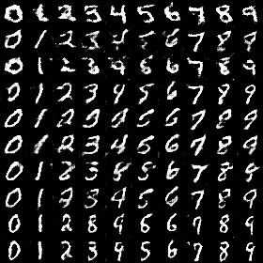
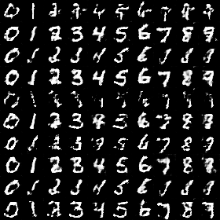
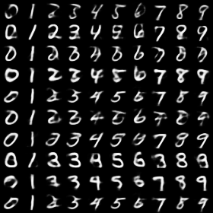
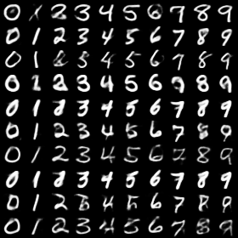
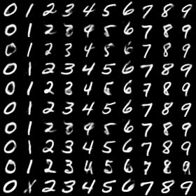
MNIST
Epoch2
Epoch10
Epoch25
CGAN
Epoch2
Epoch10
Epoch25
CVAE

Slide 24
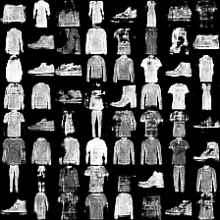
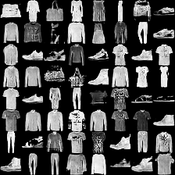
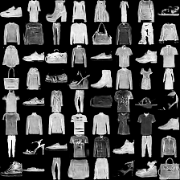
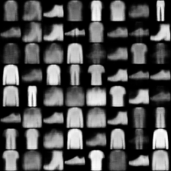
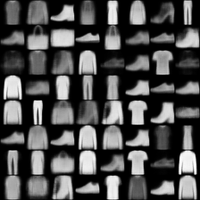
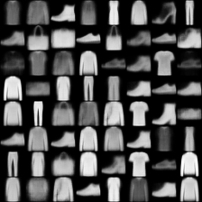
Fashion-MNIST
Epoch2
Epoch10
Epoch25
GAN
Epoch2
Epoch10
Epoch25
VAE

Slide 25
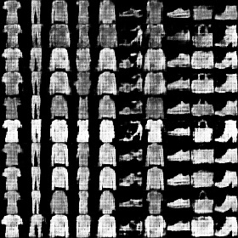
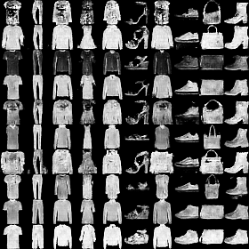
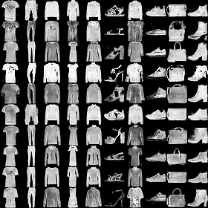
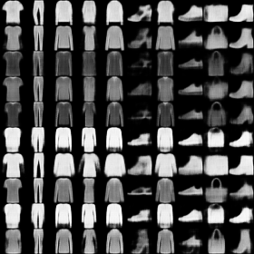
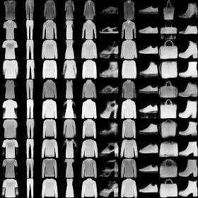
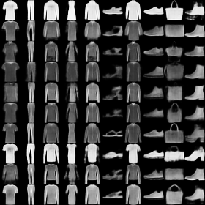
Fashion-MNIST
Epoch2
Epoch10
Epoch25
CGAN
Epoch2
Epoch10
Epoch25
CVAE

Slide 26
Comparison and Analysis
GANs and Auto-encoders are generative models which are used to learn a data distribution.
Generative Adversarial Networks (GANs) are based on a mini-max game with the objective to find Nash equilibrium between Generator and Discriminator. The idea is to sample from a Gaussian and then learn to transform the noise to mimic real data distribution using neural networks.
Variational Auto-encoder (VAE) is a probabilistic graphical model rooted in Bayesian inference i.e., the model aims to learn the underlying probability distribution of the training data so that it could easily sample new data from that learned distribution. The idea is to learn a low-dimensional latent representation of the training data called latent variables (variables which are not directly observed but are rather inferred through a mathematical model) which we assume to have generated our actual training data.

Slide 27
Comparison and Analysis
The best thing of VAE is that it learns both the generative model and an inference model. Although both VAE and GANs are very exciting approaches to learn the underlying data distribution using unsupervised learning but GANs yield better results as compared to VAE. In VAE, we optimize the lower variational bound whereas in GAN, there is no such assumption. In fact, GANs don’t deal with any explicit probability density estimation. The failure of VAE in generating sharp images implies that the model is not able to learn the true posterior distribution. VAE and GAN mainly differ in the way of training.
One of the cool thing about GANs is that they can be trained even with small training data. Indeed the results of GANs are promising but the training procedure is not trivial especially setting up the hyperparameters of the network. Moreover, GANs are difficult to optimize as they don’t converge easily. Of course there are some tips and tricks to hack GANs but they may not always help. Also, we don’t have any criteria for the quantitative evaluation of the results except to check whether the generated images are perceptually realistic or not.

Slide 28
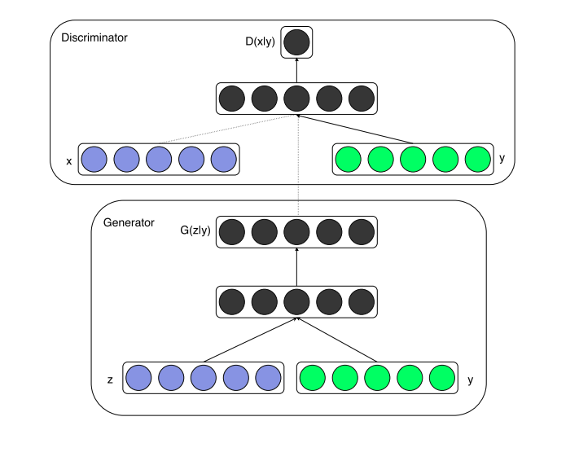
Comparison and Analysis
Conditional GAN is one of the most widely used kind of GANs which simply adds one conditioning vector with the original noise vector. By conditioning the model on additional information which is provided to both generator and discriminator, it is possible to direct the data generation process. Conditional GANs are used in a variety of tasks such as text to image generation, image to image translation, automated image tagging etc. A unified structure of both the networks has been shown in the diagram right.
CGAN structure with y as the conditioning vector

Slide 29
Reference
Goodfellow I, Pouget-Abadie J, Mirza M, et al. Generative adversarial nets[C]//Advances in neural information processing systems. 2014: 2672-2680.
Mirza, Mehdi, and Simon Osindero. "Conditional generative adversarial nets." arXiv preprint arXiv:1411.1784 (2014).
Kingma, Diederik P., and Max Welling. "Auto-encoding variational bayes." arXiv preprint arXiv:1312.6114 (2013).
https://github.com/TwistedW/pytorch-GANs
https://github.com/hwalsuklee/tensorflow-generative-model-collections
https://towardsdatascience.com/deep-generative-models-25ab2821afd3

